Slide 1

ADIDAS GROUP:IT MULTI-SOURCING
BY
PRATHIMA SUNDAR RAMAN (1001909438)
MUKESH JAISANKAR (1001909439)
SHELDON LOBO (1001950423)

Slide 2
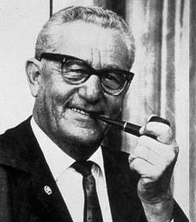

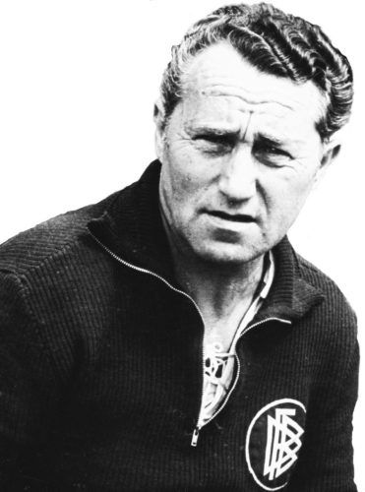

COMPANY HISTORY
Rudolf ‘Rudi’ Dassler
Introduction of
Dassler Brothers Shoe Factory
Dassler Brothers Shoe Factory gets split.
1918
1924
1936
1947
1949
Production of Sport Shoes
Dassler Shoes’ were featured in Olympics
Adi registered ‘adidas’ and Rudi
Established Ruda (now Puma)
Adolf ‘Adi’ Dassler

Slide 3

GOALS OF ROUTE 2015
THE FIVE-YEAR STRATEGY (2010 – 2015)
Achieve $17 Billion Euros in Net Sales by 2015
Grow profits faster than net sales, by achieving five years earnings CAGR of 15%
Achieve a sustainable operating margin of 11%

Slide 4





GROWTH OVER THE YEARS
In 2022, Adidas is the largest Sports Wear Company in Europe.
Second largest Sports Wear Company in the world, following Nike.
It is also, one of the “true multi-sports specialist” by including various sports apparels.
Operates in 150 countries
57,000 Employees
$23 Billion Euros
2,533 Outlets
Production of 448 M Shoes
Adidas expanded its operation by involving sourcing, logistics, production, marketing and retailing.

Slide 5
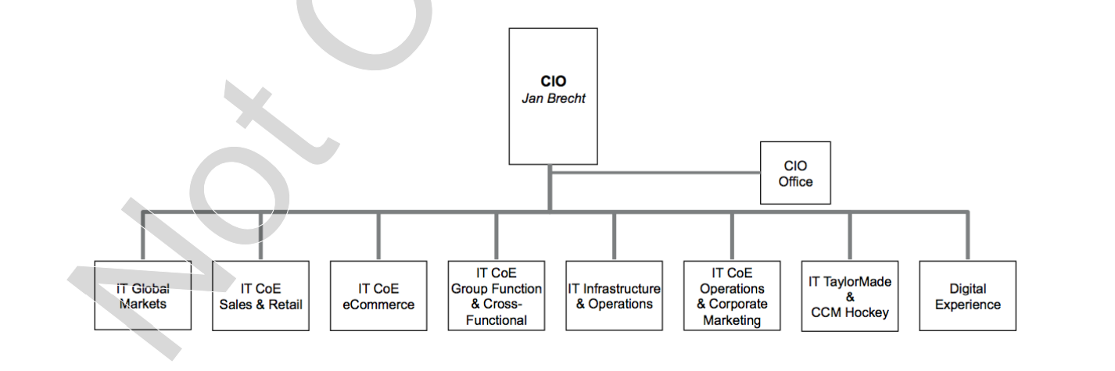

ADIDAS – IT ORGANIZATION
Worldwide, adidas has a total of 1,050 IT experts (approx.) working closely with all brands and functions of the group.
The structure consists of eight subdivisions, and dedicated IT Centre of Excellence (CoE) provide services to business.
Thus, making each IT division (vertical) convenient to connect with its internal customers on the business side.
The vertical organization structure of the adidas was perceived to be highly successful in terms of achieving business alignment and consumer satisfaction.

Slide 6

ABOUT ADIDAS VENDOR
The adidas group relied heavily on one offshore vendor from India known as the “Alpha”.
- Alpha had a monopoly on outsource projects and had long displayed complacent tendencies.
- Started to refuse negotiating and were non-responsive to price reduction.
- They were doing only the bare minimum work required and not going that extra mile
- Their quality of work has declined over the years.
- Above all, adidas did close their negotiating leverage.

Slide 7
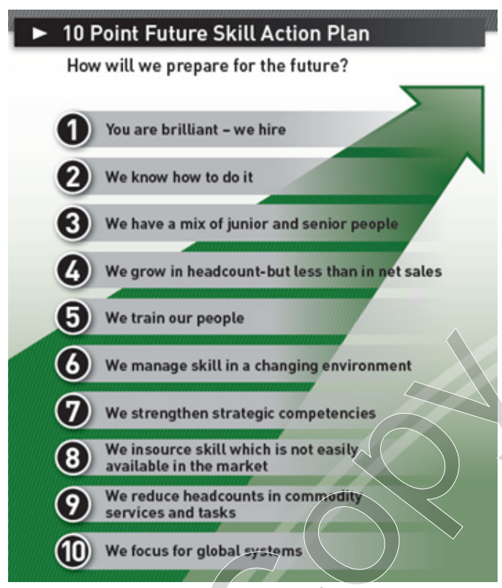
MULTI-VENDOR OFFSHORING AT ADIDAS
Jan Brecht, the new CIO in 2009 found that the relationship with an Indian tier-1 vendor was very mature.
Outsourcing based on one vendor, made Brecht question himself “ What do I want to do internally?” as the question “What functions or tasks should I outsource” is not sufficient.
Brecht and his team produced two strategic plans:
- They developed “10 Point Future Skill Action Plan” (This plan clearly described what knowledge and skills adidas Global IT employees should hold internally and acquire form the market.
- To involve multi strategic IT vendors which will be helpful in improving the competitiveness and maturity of the group.

Slide 8
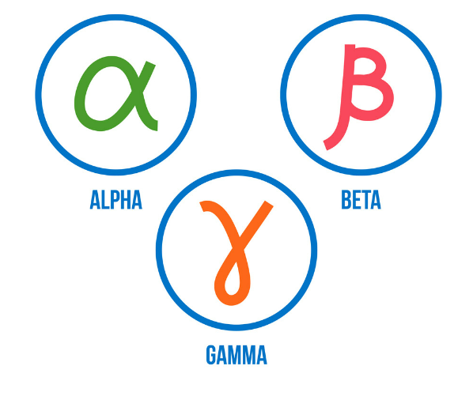
ONBOARDING VENDORS
Adidas did consider contenders near shore and far shore including companies from India, Eastern Europe and the Soviet Union.
The strategic plan was to have the vendors compete for the available projects which helps to improve the quality of work and responsiveness while reducing the costs.
Two additional Vendors – ‘Gamma’ from India and the other ‘Beta’ from Eastern Europe.

Slide 9


ADIDAS GROUP : CASE QUESTIONS
What should adidas do to preserve and expand the gains from multi-sourcing?
- Sustain intense vendor competition, at the same time keep all three vendor sufficiently motivated to invest in client relationship.
- Continue reducing average duration of vendor contracts and inclusion of performance improvement clause.
How do the multi-sourced vendors appear to reach to such a strategy?
- Alpha seemed to have a positive approach where they were more responsive to client’s needs and offer higher service quality for low prices.
- While on the other hand, Beta and Gamma went through a learning curve to understand adidas business. Further they did provide creative and competent service with their overlapping skill sets and areas of expertise.

Slide 10
Multi-Sourcing
PROS
cons
Save Costs - Best possible product/service for least cost
Promotes Innovation - differentiating themselves from their competitors
Increased control and visibility
Reduce Overall IT costs and Indirect costs
Flexible
Transfer risk, accountability to vendors
Increased learning opportunities; diverse set of unique vendor resources and skills
Improved service quality and time to market
Require far more monitoring and management time and effort
Standardizing governance across multiple vendors can be tough, given they all have their own models and processes
Employees hesitant to change from one vendor to multiple vendors
Dysfunctional vendor competition
Reduced profit margin

Slide 11
ADIDAS GROUP : CASE QUESTIONS
What should adidas’ management do to increase the likelihood of having a long-term success with their multi-sourcing strategy?
- Adidas should keep the vendors motivated, by improving the internal management structures and processes to achieve long term success.
What might happen if they do not go ahead with some of the options to “shake-up” the existing multi-sourcing arrangements?
- The current vertical units will continue to break down IT projects into smaller pieces and conduct RfPs with three vendors. - Individual RfPs frequently had business volumes as low as 10,000 pounds. - This is a concern since it makes working with Adidas undesirable to suppliers. They lack the cooperation needed for the transaction

Slide 12

ADIDAS GROUP : CASE QUESTIONS
Does it make sense for adidas to establish a captive IT service center?
- Captive centers are client-owned and operated service delivery centers. They are typically situated in a low-cost location that provides services directly to the parent organization.
‘Captive IT centers are owned by the company and not the vendor’
Advantages of a captive IT center
Cost effective
Full operational control and monitoring
Minimize intellectual and data security risk

Slide 13

ADIDAS GROUP : CASE QUESTIONS
Why should adidas NOT establish its own captive IT center?
No !!!!! Why?
Adidas is not an information system but a product-based company
The focus should be more on marketing and product development
21 % of total global sales come through E-Commerce
Expensive to build infrastructure, hire and train staff
Difficult to attract top professional

Slide 14

ADIDAS GROUP : CASE QUESTIONS
What are the pros and cons of nearshoring (e.g., Spain) vs. far shoring (e.g., India)?
- Outsourcing is the business practice of hiring a party outside a company to perform services or create goods traditionally performed in-house by the company's employees and staff. Outsourcing is a practice usually undertaken by companies as a cost-cutting measure.
Far shoring- It is also known as offshoring or offshore outsourcing. It is a business practice of hiring vendors in the search for the best price for the service, companies often decide to source their software development requirements to the far-flung location, hiring remote employees from the Middle East, India or China.
Nearshoring- nearshoring means ‘near’ to your location. It refers to moving your operations or hiring a team in a location that’s different, but still in the same region. This includes neighboring countries in the same or similar time zones.

Slide 15
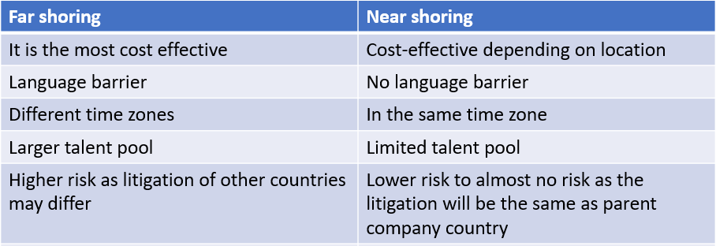
ADIDAS GROUP : CASE QUESTIONS
In the case of the Adidas group, it is more feasible to opt for far shoring than nearshoring as outsourcing is opted by companies to minimize the cost and focus on more critically aspects like design marketing and production which can be successfully accomplished by far shoring IT processes.
Secondly, due to the location of Adidas headquarters in Germany, it will be more expensive to nearshore because of the high hourly rate and limited talent pool.

Slide 16
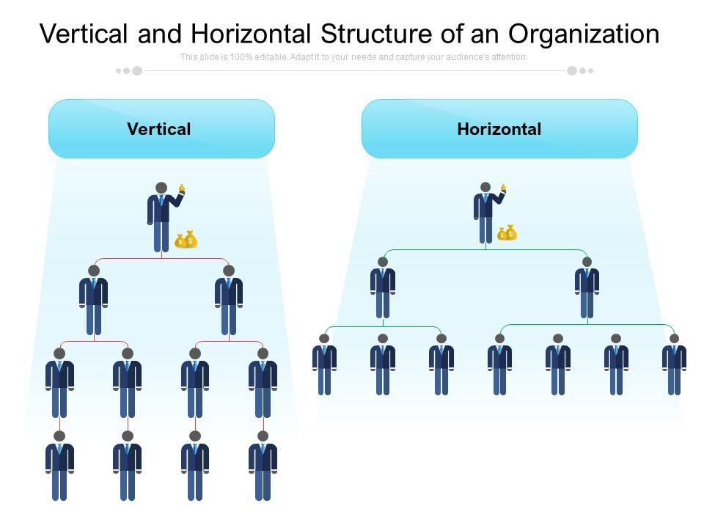
ADIDAS GROUP : CASE QUESTIONS
VERTICAL ORGANIZATION
Business with a large of employees often choose vertical [top-down management] , which is structed like a pyramid – with executives at the top , midlevel managers in the middle, and low-level managers and employees at the bottom.
HORIZONTAL ORGANIZATION
While business with a smaller number of employees often choose horizontal [ flat management] , as a CEO with industry experience might directly work with a software development team. There are fewer divisions exist between executives in senior positions and staffs.

Slide 17
ADIDAS GROUP : CASE QUESTIONS
How might horizontal structuring help the adidas’ IT group ? In what ways would it be an improvement over vertical structuring?
- According to Brecht’s idea of inserting the horizontal structure into vertical, will create a matrix structure, proceeding the vertical units to mirror the organization on the business side and horizontal units (application development, testing and support) will pool resources across the vertical units.
Benefits from horizontal structure
- Reduce redundancy across verticals
- Able to act quickly without having to wait for supervisors' approval (less bureaucracy)
- Empowering employees to take decisions leaving them feel much more satisfied (Greater job satisfaction) and more creativity.
- Easier to share information among team members and that creates a team environment
- Gives vendors good business growth opportunities by leveraging economies of scale on vendor’s side

Slide 18


ADIDAS GROUP : CASE QUESTIONS
In what ways would it be worse than vertical structure? How should adidas’ IT Group change its structure, if at all?
Horizontal Structure has its own disadvantages on a long run,
- As the business grows horizontal structure will not be able to foster a culture of teamwork.
- Also leads to employees being less sure of their role and responsibilities within an organization.
If Adidas decides to change its structure, it cannot be horizontal or vertical structure rather it could be the best from both.
The Matrix structure helps the management to decide upon staff lining along functional, geographic and product lines too with the inclusion of both Functional Manager and Product Line Manager, where the former helps the employees to improve their skills and prioritize work and the latter sets the direction on product offerings by the company.
Functional Manager
Product Line Manager
Employees

Slide 19
THANK YOU !
ANY QUESTIONS?

